Slide 1
Determining Concrete Compressive Strength Based on Different Material Properties
Department of Statistics & Data Science
Jahangirnagar University
Submitted to
Farhana Akter Bina
Assistant Professor
Submitted by
Group Name: Apolo 11
ASDS Batch 12

Slide 2
Project Background
Concrete compressive strength is vital for structural integrity
Material properties like cement, blast furnace slag, fly ash, water, superplasticizer, coarse aggregate, sine aggregate, water-cement ratio, and curing conditions profoundly influence on the strength of concrete
Understanding these interactions enhances concrete mix design and structural performance
Studying these factors enables the development of predictive models for optimized concrete formulations

Slide 3
Project OBJECTIVE
To investigate the influence of various material properties in concrete
To quantify the impact of each material parameter on concrete strength
To develop predictive models for optimizing concrete mix designs
To add values in future construction projects

Slide 4
Data Source
The data contains compressive strength of concrete and its different materials
The data contains one dependent variable and eight independent variable
The data has been collected from www.kaggle.com

Slide 5
Analysis tools
Python version 3.11.5 has been used to implement code in jupyter notebook
Used Libraries - pandas, matplotlib, skitlearn, seaborn, missingno, scipy.stat etc

Slide 6
Data Preprocessing
Imported the necessary libraries
Loaded the dataset
Summary information about the data frame have been checked
Identified missing values
Extracted the dependent variable for analysis
Normalize the dataset

Slide 7
Analysis Techniques
Summery Statistics
Summary Stat. | Cement | Blast Furnace Slag | Fly Ash | Water | Superplasticizer | Coarse Aggregate | Fine Aggregate | Age (day) | Concrete Compressive Strength
count | 1030.00 | 1030.00 | 1030.00 | 1030.00 | 1030.00 | 1030.00 | 1030.00 | 1030.00 | 1030.00
mean | 281.17 | 73.90 | 54.19 | 181.57 | 6.20 | 972.92 | 773.58 | 45.66 | 35.82
std | 104.51 | 86.28 | 64.00 | 21.36 | 5.97 | 77.75 | 80.18 | 63.17 | 16.71
min | 102.00 | 0.00 | 0.00 | 121.75 | 0.00 | 801.00 | 594.00 | 1.00 | 2.33
25% | 192.38 | 0.00 | 0.00 | 164.90 | 0.00 | 932.00 | 730.95 | 7.00 | 23.71
50% | 272.90 | 22.00 | 0.00 | 185.00 | 6.35 | 968.00 | 779.51 | 28.00 | 34.44
75% | 350.00 | 142.95 | 118.27 | 192.00 | 10.16 | 1029.40 | 824.00 | 56.00 | 46.14
max | 540.00 | 359.40 | 200.10 | 247.00 | 32.20 | 1145.00 | 992.60 | 365.00 | 82.60

Slide 8
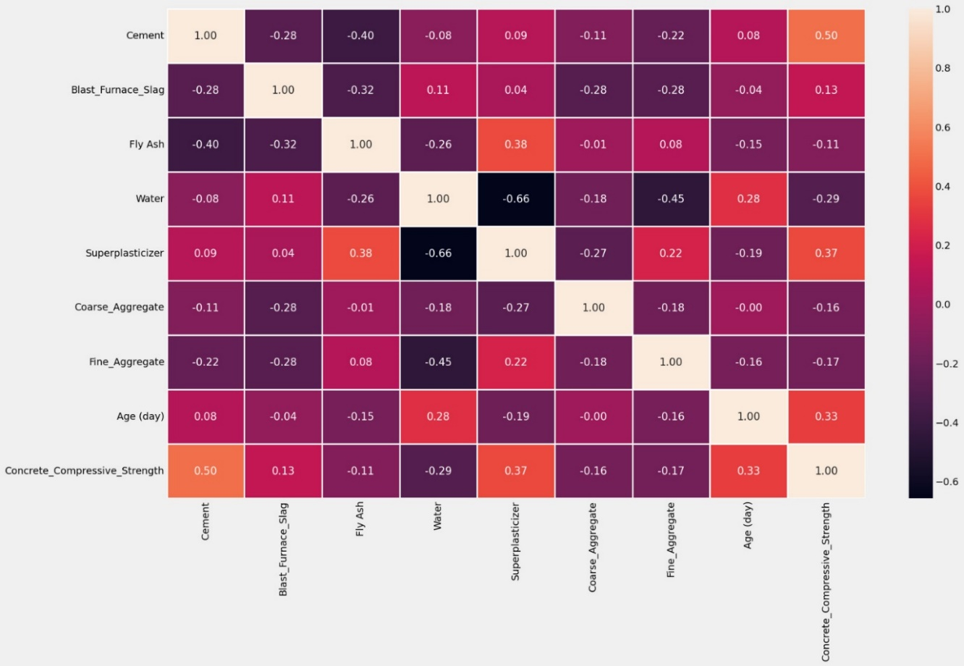
Analysis Techniques
Correlation among variables

Slide 9
HeatMap interpretation
Cement and Concrete Compressive Strength is moderately positively correlated and relevant value is 0.50
Superplasticizer and Concrete Compressive Strength is moderately positively correlated and relevant value is 0.37
Age and Concrete Compressive Strength is moderately positively correlated and relevant value is 0.33
Water and Concrete Compressive Strength is moderately negatively correlated and relevant value is -0.29

Slide 10
Multiple linear regression
Model-
Y = β₀ +β₁X₁+ β₂X₂+ β₃X₃+ β₄X₄+ β₅X₅+ β₆X₆+ β₇X₇+ β₈X₈+ U
Found Regression coefficient of eight independent variables-
Regression Coff. (β) | β₁ | β₂ | β₃ | β₄ | β₅ | β₆ | β₇ | β₈
values | 8.86 | 5.47 | 0.68 | -4.24 | 2.61 | 0.10 | -0.91 | 9.99

Slide 11
Interpretation of Model
Here concrete compressive strength is increasing by 8.86 % for the increase of 1 % cement
Concrete strength increased by 5.47 % for the increase of 1 % Blast furnace slag
Concrete strength increased by 9.99 % for the increase of 1 % Age(Day)
Also concrete strength decreased by 4.24% for the increase of 1% water

Slide 12
Interpretation of Model
Co-efficient of determination , R² = 0.80
Here dependent variable is explained 82% by the independent variables
This can be concluded as a good fitted model

Slide 13
Practical Application
Infrastructure projects, such as bridges, highways, and buildings, require concrete with high compressive strength
Optimize the proportions of materials in the concrete mixture to achieve the desired compressive strength
Selected concrete mixtures are field-tested in real-world applications
The analysis provides a basis for further research and development in concrete technology

Slide 14
Conclusion
Model Fitting
Impact on concrete compressive strength
Found R square value is 0.80
This is a moderately good fitted model
Cement, Blast furnace slag, Age and Water have high impact on the compressive strength of concrete

Slide 15
Any Questions?
Thankyou

